Slide 1
Analysis of Global Greenhouse Gas Emission
Shweta Dutta
13.11.2019

Slide 2
Outline
Climate Change – Greenhouse Effect
Purpose of the Project & Data Structure
Analysis
Conclusion
Further Studies
Notes:
A glimpse through what is GHG and how the climate is getting affected
Purpose of the project
Analysis undertaken
Finally the conclusion from the analysis and further studies that can be done

Slide 3
Climate Change – Greenhouse effect
Changes are caused by extra heat in the climate system due to the addition of greenhouse gases to the atmosphere
Greenhouse gases - Water vapour, carbon dioxide, methane, nitrous oxide, ozone and some artificial chemicals such as chlorofluorocarbons (CFCs)
Greenhouse effect - Natural process that warms Earth’s surface
Enhanced greenhouse effect / Global Warming –
Process that raises the Earth’s temperature due to human factors
Impact -
Increased Air Temperatures
Ocean Warming and sea level rise
Extreme Weather events
Rainfall Patterns
Notes:
The climate we are living in is changing.
The changes are caused by extra heat due to greenhouse gases in the atmosphere.
The additional greenhouse gases are caused by human activities such as the burning of fossil fuels, agriculture, and land clearing.
The major greenhouse gas is carbon dioxide (CO2) and nearly all CO2 comes from fossil fuels and land-use change. But methane (CH4) and nitrous oxide (N2O), which mostly come from agriculture and waste, are also significant GHGs and shouldn't be discounted.
Greenhouse effect is a natural process that warms the Earth’s surface: The normal temperature is 33 degree C
Many of the impacts of climate change pose risks to human and natural systems.
Some major impacts are : …
#Wet areas are likely to get wetter and dry regions are likely to be drier in response to climate change.

Slide 4
Purpose of the Project & Data Structure
Challenges - Rising levels of manmade greenhouse gases (GHGs) in the atmosphere and their resulting impact on climate
Purpose –
Identify the main source (economic sector and country/ continent) of greenhouse gas
Find how the emission values have changed over the years
Forecast how much greenhouse gases will be emitted in future
Data for the project -
Source: Food and Agriculture Organization of the United Nations
Data on Emissions of greenhouse gases by gas, economic sector, country and year from 1990-2010.
147 obs. of Total Emission values
7 levels of Area - Asia, Africa, Europe, Oceania, North, Central and South America
8 levels of Items - Energy, Transport, Residential/ Commercial/ Institutional, Industrial Processes, Agriculture, Land use sources, Other sources, Waste
4 levels of Elements - Emissions from CO2, CH4, N2O, F gases
Missing Values - Absent
Notes:
Challenge and Purpose:
Both technological and environmental challenge
# Should audit GHG fluxes at the factory, city, country and continental level
Monitoring of GHG
The possible questions now arise are:
How have global emissions of major GHG changed over time?
Which sector yield maximum greenhouse gas?
Which country/ continent is responsible for maximum emission of greenhouse gases?
Data Structure:
For simplicity purposes and to have a broader picture, data was reshaped from 40,000+obs. to 147obs.
231 countries to Continents and three parts of America are considered.
Columns containing ‘total emission values’ from each sectors are included.
# Few columns of ‘total sources’ that had aggregate values were excluded.
# Share of gases in the sector and share of sectors in each gases are excluded.
Only the 4 major gases emission values considered.
Initially, dataset had multiple missing values.

Slide 5
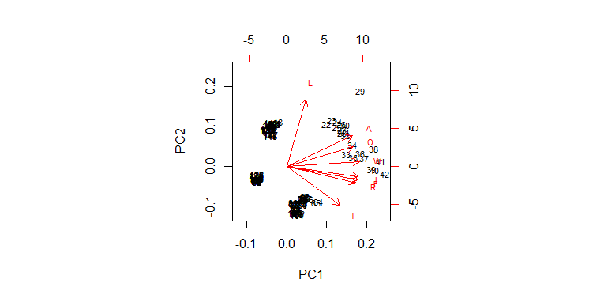
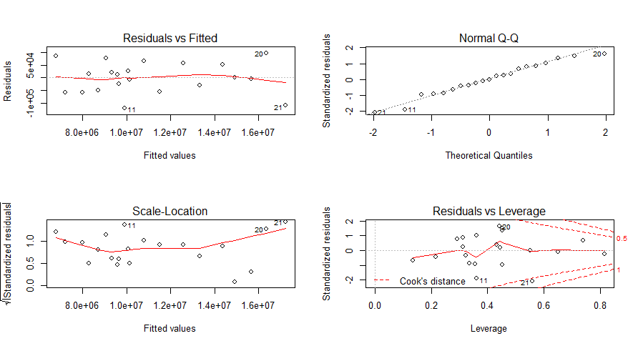
Analysis
Principal Component Analysis:
Uses orthogonal transformation to convert correlated variables into a set of linearly uncorrelated variables
First two principal components explain 93.15% of the total sample variance
Linear Discriminant Analysis:
Finds the linear combinations of the original variables giving the best possible separation between the groups in the data set
At most 6 useful discriminant functions to separate the emissions by levels
LD1 explains 57.66% of the total variance
MANOVA:
Tests for the difference in two or more vectors of means
Mean values of Areas of Source and GHG variables are significantly different
Multiple Regression:
To predict the value of a variable based on the value of two or more other variables
Regressing “Emission of CO2” on other variables, Adjusted R square - 99.94%
Biplot of 2 PCs
Plots obtained from “Regressing Emission of CO2 on other variables.”
Notes:
PCA and LDA are the methods used for Data reduction
Principal Component Analysis:
Finds the best low dimensional representation of variation in the multivariate data set.
In the dataset, we have emission values from 8 different resources obtained from 7 different levels.
Carried out PCA after scaling the data.
It is observed that the first principal component explains 74.87% of the total sample variance. The first two principal components collectively explain 93.15% of the total sample variance.
The data from 147 observations on 8 variables reduced to 147 observations on 2 principal components.
#Also, the principal components are predicted after that and the rotation matrix is also obtained.
#Suppose there are p components that produces the total system variability, often it is observed that much of this variability can be accounted for by a small number of principal components, say k<p. In such case, the k principal components can replace the initial p variables and the original data set of n observations on p variables reduces to a data set consisting of n observations on k principal components.
Biplot displays the data points along the PCs and indicates the contributions of each of the variables to these PCs.
Linear Discriminant Analysis:
PCA doesn’t pay any attention to groupings in the data and finds axes that maximize total variation. But, LDA is used for separating classes.
Data set has 7 groups which are the levels.
Maximum number of useful discriminant functions that can separate the emission values by levels is the minimum (G-1, p) = minimum (6, 8) = 6.
#LDA is used to find axes (linear combinations of variables) that best separate predefined groups. The axes maximize variation between groups relative to variation within groups. Also known as “canonical discriminant analysis”, or “discriminant analysis”.
#Can predict the value of all 6 discriminant functions and matrix of loadings of discriminant functions is obtained.
Proportion of Trace - Proportion of between-class variance explained by successive discriminant functions
Stacked Histogram displays the results of LDA where a stacked histogram of the values of the discriminant function for the samples from different groups.
MANOVA:
ANOVA or Analysis of Variance is a group of statistical models to test for significant difference between means - tests whether the means of various groups are equal or not.
# Tests the effect of one or more independent variables on two or more dependent variables
MANOVA is extension of ANOVA, takes a combination of dependent variables
#Assumptions:
#Independent Observations - Independent Random Sampling - MANOVA assumes that the observations are independent of one another
#Independent Variables – Categorical, Dependent Variables – Continuous
#Absence of Multicollinearity - dependent variables cannot be too correlated to each other
#Multivariate Normality
#Homogeneity of Variance - Variance between groups is equal
Carried out MANOVA to test difference of means of the various groups of Area of
4 variables “Emission of GHG”
8 variables “Emission from Sources”
In both the cases, we reject the null hypothesis as p value<0.05
Multiple Regression:
Multiple regression is an extension of simple linear regression.
Multiple linear regression attempts to model the relationship between two or more explanatory variables and a response variable by fitting a linear equation to observed data.
#Variable to be predicted – Dependent variable
In the given data set, the variables “Emission of CO2, CH4, N2O, F gases” are dependent in nature with that of the variables of “Emission from sources”. Since there share of values are already included in the other variables of “Emission from sources”.
Thus, we can regress the dependent variables on the independent variables, keeping an area fixed, and predict the future values of gases when the emissions from sources are already know to us.
The first plot (down left) gives the plot of “Residual v/s Fitted values”
The second plot (down right) gives the Normality Q-Q plot. Most of the values fall on the straight line and thus it can be commented that the values follow Normality assumption.
The observations with the index 11, 20, 21 i.e., on the years 2001, 2009, 2010 are considered as outliers.
Note: Similarly, for other areas also, similar results can be obtained.

Slide 6
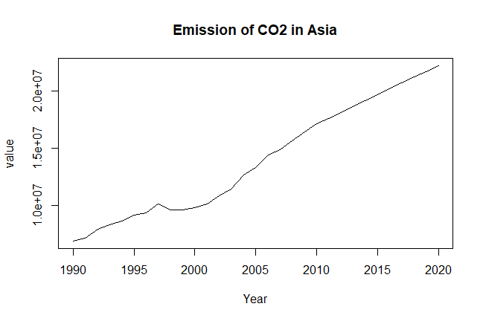
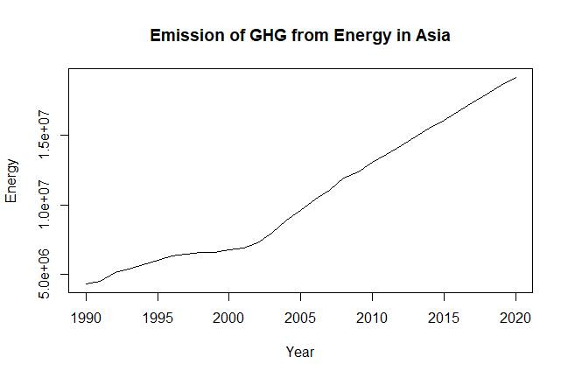
Time Series Forecasting
Forecasting - Method for predicting probable amount in the future, based on the analysis of past amount under the present condition
Autocorrelation measures correlation between observations as a function of the time lag between them
Results:
All the variables have significant auto correlation
Data set can be considered as a Time Series Data of 21 years
Auto Regressive Integrated Moving Average model is fitted to the data
Based on ARIMA model, forecast is generated for all the variables for next 10 years
Asia
Notes:
When the past data is used to predict the future amounts, then this method is referred as time series method.
Examples of method of Time Series Forecasting include Moving Average, Exponential Smoothing, and ARMA/ARIMA etc.
Values of autocorrelation imply the values of emission on a year significantly depends on that of the past years.
From the forecast values obtained, a graph can be plotted between years and the emission values to notice where the future is heading towards.
From the graph above, it can be seen that there has been extreme increase in emission of CO2 gas in Asia, and the forecast also shows that the amount will keep on increasing in future.

Slide 7
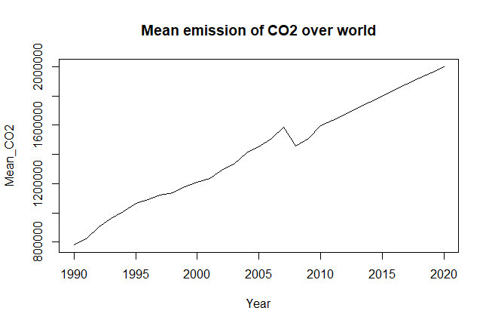
Conclusion
Fig.1
Fig.2
‘Energy’ is the main source of GHG
‘CO2’ is the major GHG
Considering Asia, in future extreme increase in
Emission of CO2 gas
Emission of GHG from ‘Energy’ sector
High increase in ‘Emission of CO2’ in the world, in future
Fig.3
Fig.1 ‘Energy’ and ‘Land’ are the main sources
Fig.2 CO2 is the most abundant GHG
Fig.3 Graph of future value of CO2 in the world
Further Studies
To have a more generalized method of forecasting for better forecasts
Carry out similar analysis to have a detailed picture considering each countries
Notes:
Conclusion:
Considering most recently collected data for the year 2010, we can observe that ‘Energy’ is the main source of GHG followed by ‘Land’, and ‘CO2’ is the most abundant GHG.
Energy ~ 25 lakh gigagram
Asia being the greatest continent has the maximum average GHG under all sectors
#Emission values of most Sources are correlated - Transport, Land has very less correlation values with some sectors
For each levels, emission of CO2 are forecasted and a overall mean was obtained for each year from 1990-2020.
From the graph of these values of CO2 against years, it can be seen that there has been increase in emission of CO2 gas in world since 1990, and it keeps on increasing in future.
More emission of CO2 will result in a severe enhanced greenhouse effect.
Thus, it is high time when each one of us should be aware of the current and upcoming environment situation and start taking steps to make the environment a better place to live.
Further Studies:
The method used here to generate forecast values is “Auto Regressive Integrated Moving Average method (ARIMA)”. The other methods “Holt Winter’s Exponential Smoothing” or “Moving Average” are not considered. Thus, it may be so that some other method gives better forecast values.
The forecast values are generated by using the “auto.arima” function in R. This function automatically chooses the best ‘p’, d’, ‘q’ values. Also, during forecast the whole of the dataset is considered and the usual procedure of dividing the data into “training” and “testing” part and then applying the method is not considered. Thus, this technique can be made more detailed, so that better forecasts are generated.
To carry out similar analysis for each country, so that each country can take necessary precautionary steps, beforehand.

